Slide 1


CompSci club
Software engineering interviews
Let’s try and get a software engineering job!

Slide 2
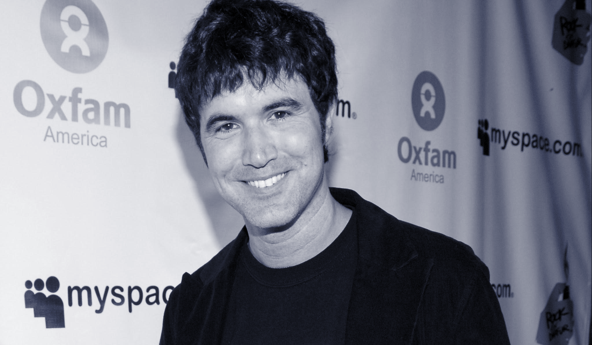
Our person of the day!
Tom Anderson
Perhaps a little bit before our time, but still incredibly influential, today we celebrate the birthday of social networking site MySpace’s co-founder Tom Anderson
Tom would be ubiquitous among MySpace users, being the first “friend” when new profiles were created
Having an interest in technology since he was young, he would hack under the name “Lord Flathead” and prompted the FBI to raid his house when he got into Chase Bank’s security
Even though it has long been surpassed by other social networking sites like Facebook, Instagram and Twitter, the impact of MySpace is hard to understate— it was the first of its kind to reach a global audience and had a tremendous impact on technology, pop culture and music
You could actually code your MySpace profile, introducing a new generation to HTML & coding
Co-Founder of MySpace

Slide 3


Roadmap for Today
Parts of (Most) Software Interviews
Let’s see what people actually expect of you
Resources
How can you be a good candidate?

Slide 4
Let the studying begin
Let’s look at some
Software Interviews

Slide 5
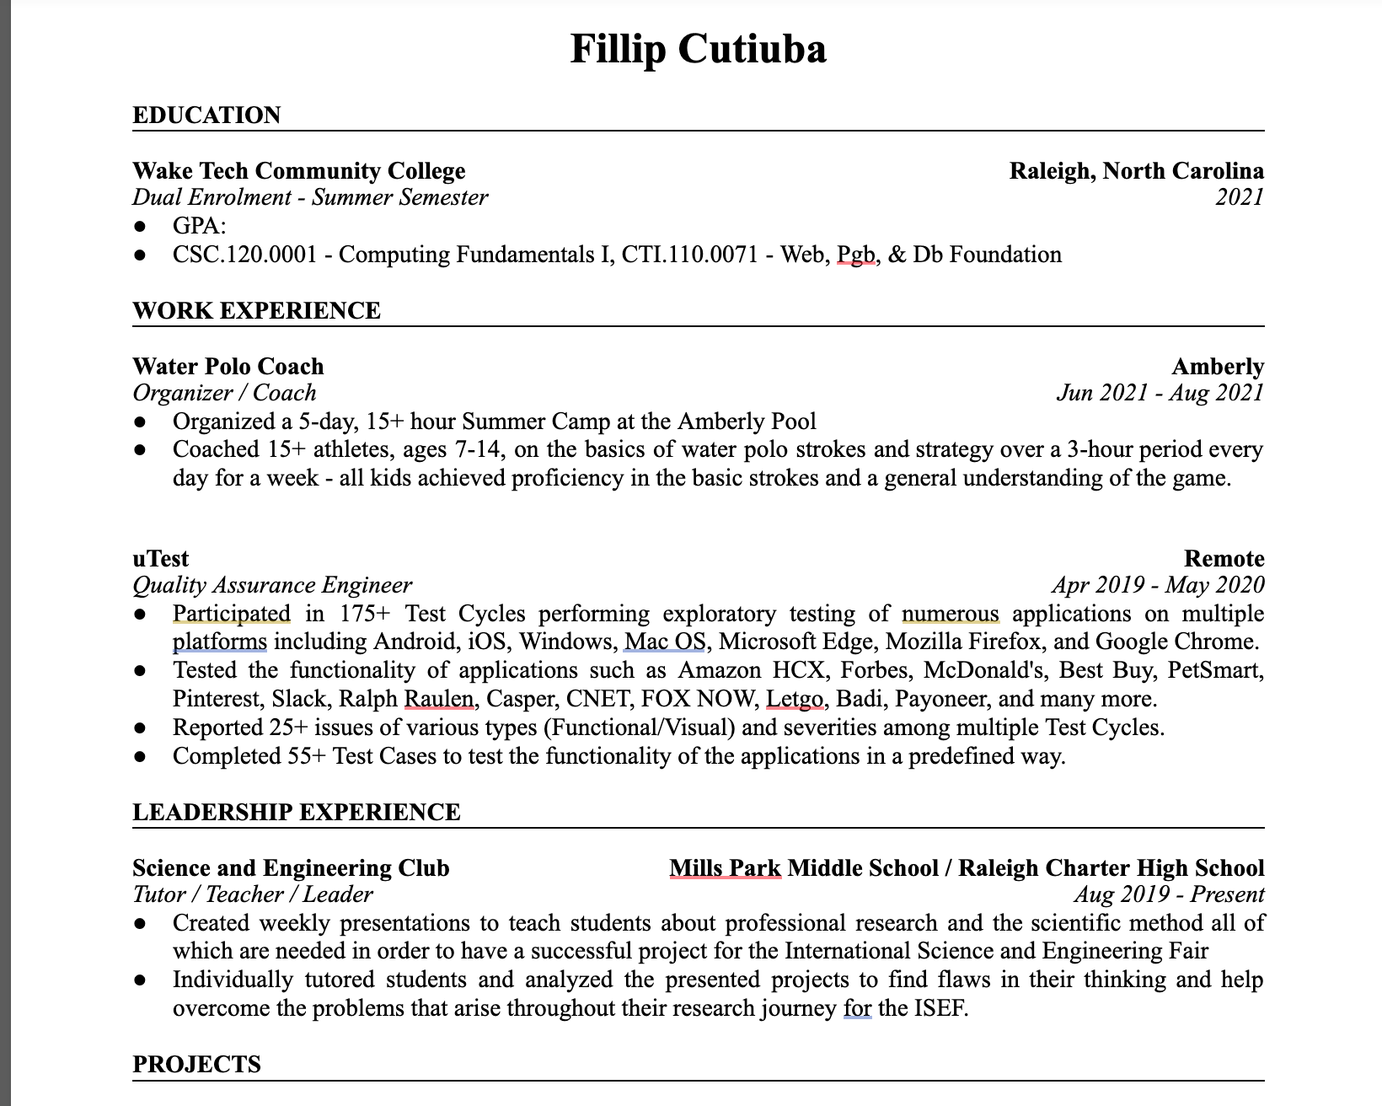
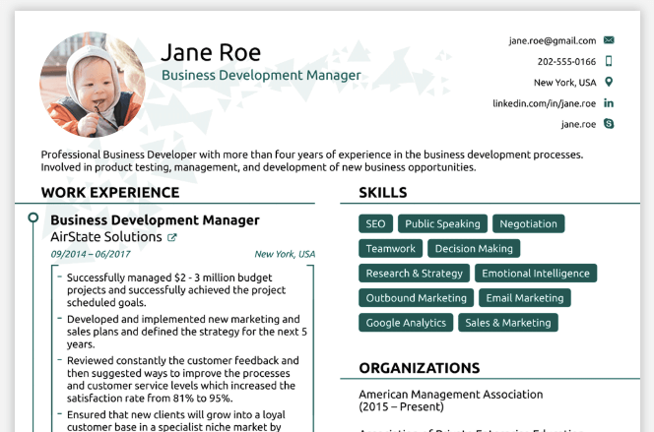
Step 1: Get a resume
We are assuming you are going to college, maybe got done with your first semester.
We need to start with getting a ATS-friendly resume so we can just start getting considered for jobs.
Let's look at some examples of good, and bad resumes and then get a template of a good one.
Template
More info: here

Slide 6

Now onto studying!
Most interviews in the top tech jobs are the same:
You apply online (on the company’s website or through a recruiter on LinkedIn or on job listing sites like Indeed) and then, hopefully, you get an interview.
At the interview, you have 2 main stages:
Technical Stage
Behavioral Stage
Lets try and tackle the two parts!

Slide 7
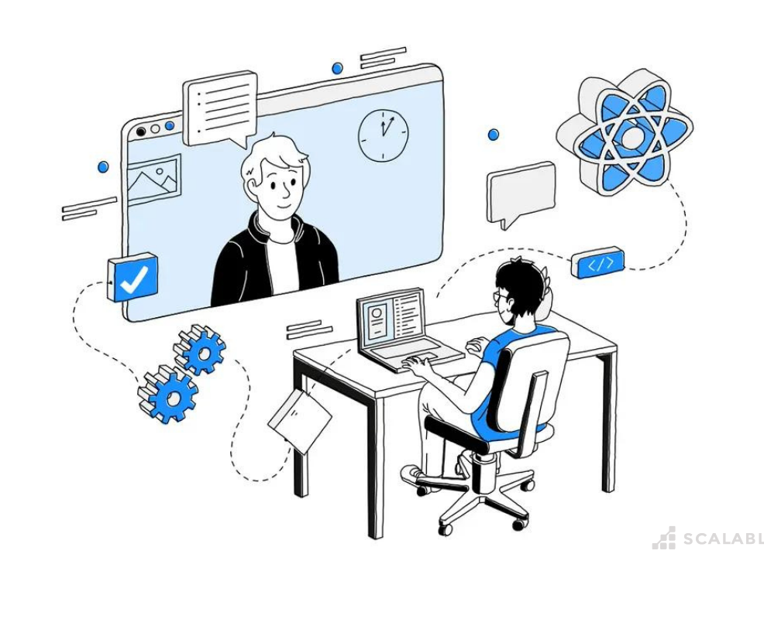
Technical Interview
In this portion of the interview, the interviewer will ask you to perform some programming task for them.
They will give you a programming problem, give you ~20-60 minutes, and tell you to solve it and also be able to explain and back the solution up
Make the code
Make the code better (running faster, cleaner, etc.)
Make sure it works (edge cases)
Here are some resources:

Slide 8
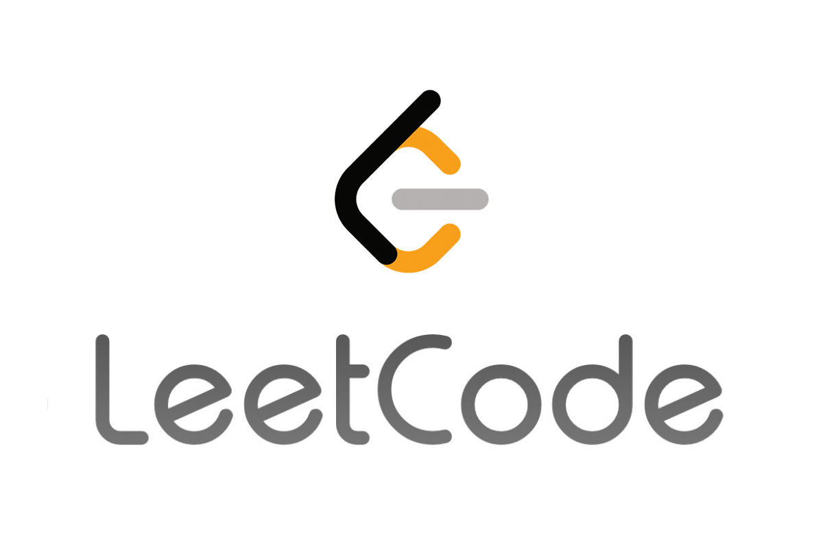
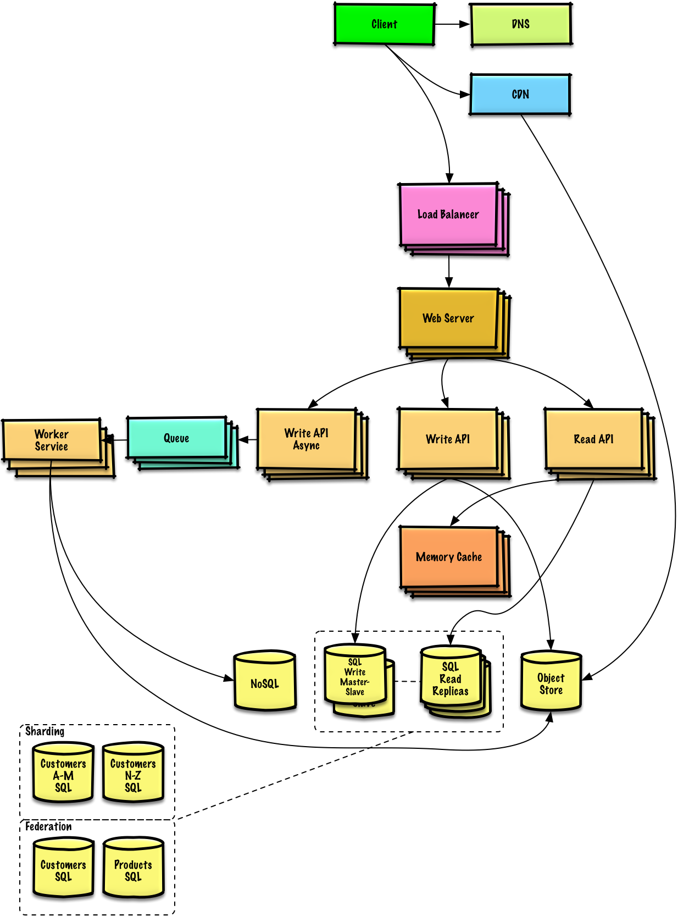
Resources for technical inter.
Tech interview handbook
Link here
Grind 75 - 75 questions that you need to know how to solve - most common technical interview questions
Leet Code - has problems the interviewers give you, and much more
System Design Primer - A guide on how to make scalable systems (you are working in huge companies now)
Designing Data Intensive Applications - the name speaks for itself.

Slide 9
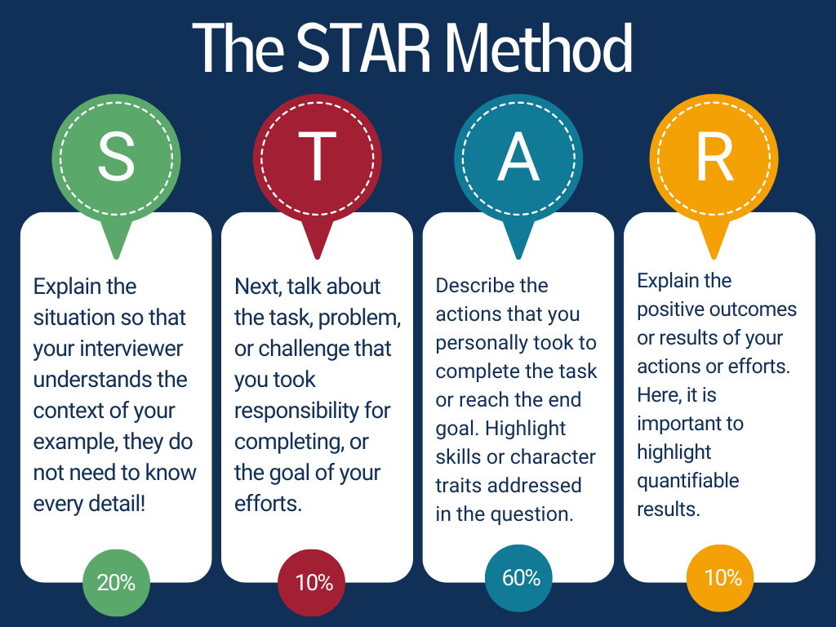
Behavioral interviews
Tech interview handbook
Link here
Amazon STAR Method!
Situation - The interviewer wants you to present a recent challenge and situation which you found yourself in
Task - What were you required to achieve? The interviewer will be looking to see what you were trying to achieve from the situation.
Action - What did you do? The interviewer will be looking for information on what you did, why you did it, and what the alternatives were.
Results - What was the outcome of your actions? What did you achieve through your actions and what did you learn? What steps did you take to improve after the experience?

Slide 10
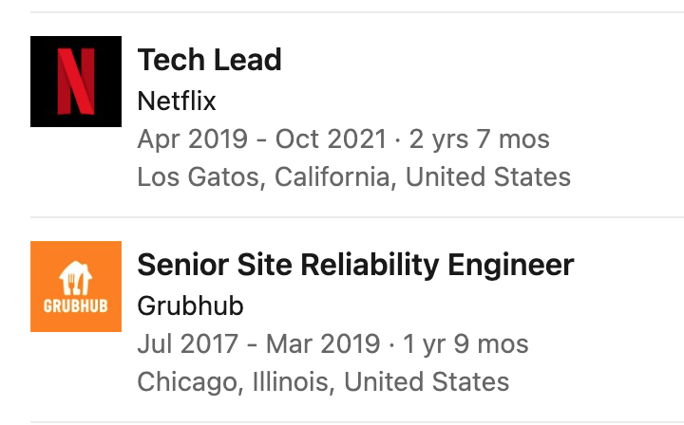
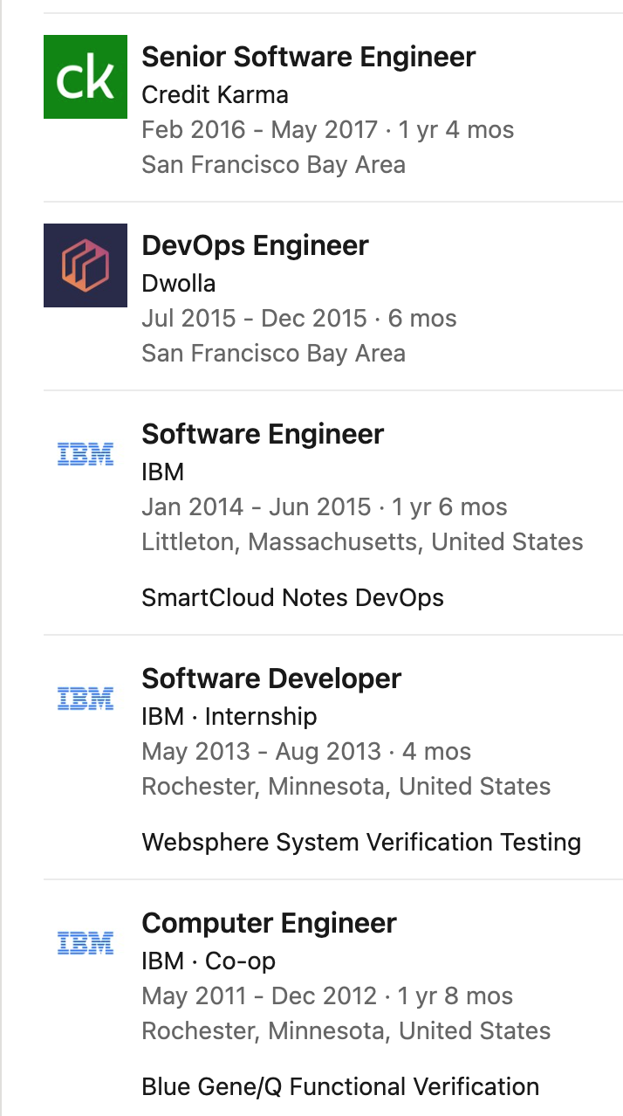
Hard Truth in Soft. eng. jobs
This is the field where staying at one job for more than a year or two years in kind of detrimental to you
Here is an example of a person I know, and let me explain:
Internal promotions go much slower than the market rate for a software engineer
This is because there is a huge need for software engineers, and not that big of a supply
Companies want the good people, and are willing to pay a lot
Staying for 1 year gives you the chance to learn new skills, get a boost in your resume, and then leave for a job that pays much more.
This person on the right started at $75-80k in 2011 and ended at $500k+ at 2019.

Slide 11
We would love to hear your thoughts now!
It’s time for
Discussion!

Slide 12
We will be back to coding and new material next week!
Thank you!
That is all we have for today!

